Slide 1
Scrum, Kanban, DevOps
Dr. Adeel Ansari

Slide 2
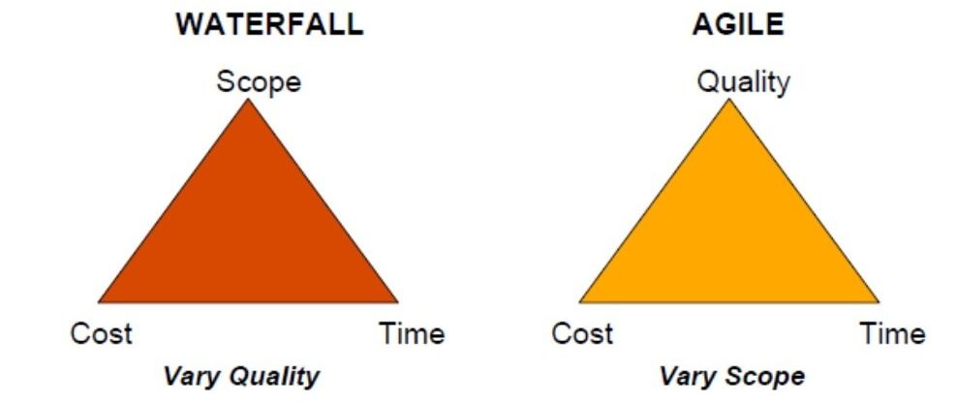
Waterfall and Agile

Slide 3
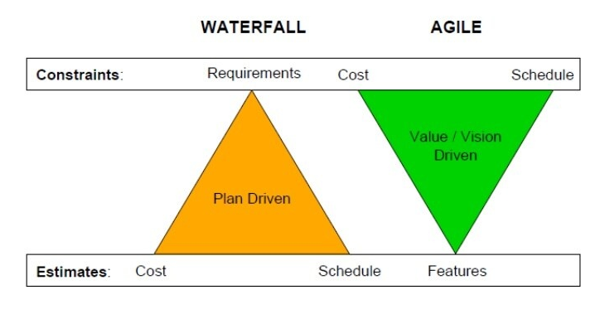

Slide 4
Agile Manifesto
Individuals and Interactions over processes and tools
Working software over comprehensive documentation
Customer Collaboration over contract negotiation
Responding to Change over following a plan

Slide 5
Principles
Customer Satisfaction by rapid delivery of useful software
Welcome changing requirements, even late in development.
Working software is delivered frequently
Working software is the principal measure of progress
Sustainable development, able to maintain a constant pace.
Close, co-operation between business people and developers.
Face-to-face conversation is the best form of communication. Projects are built around motivated individuals, who should be trusted.
Continuous attention to technical excellence and good design
Simplicity
Self-organizing teams.
Regular adaptation to changing circumstances.

Slide 6
Agile Methods
Dynamic Systems Development Method (DSDM)
Extreme Programming (XP)
Feature Driven Development (FDD)
Scrum
Kanban
Velocity Tracking

Slide 7
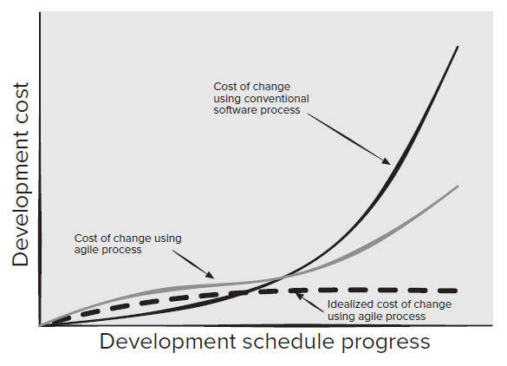
Agility and the Cost of Change
Agile process encompasses incremental delivery.
When incremental delivery is coupled with other agile practices such as continuous unit testing and pair programming, the cost of making a change is attenuated.

Slide 8
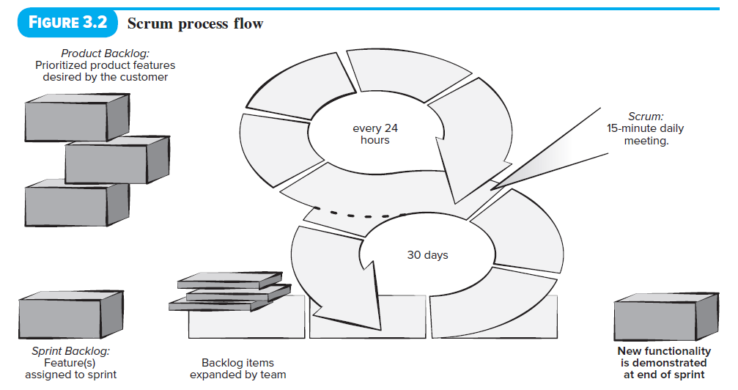
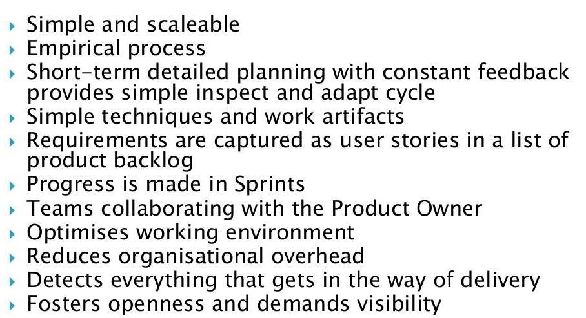

Slide 9
Scrum Process Flow
Scrum framework activities: requirements, analysis, design, evolution, and delivery.
Within each framework activity, work tasks take place in a relatively short time-boxed period called a sprint.
The work conducted within a sprint (the number of sprints required for each framework activity will vary depending on size of the product and its complexity) is adapted to the problem at hand and is defined and often modified in real time by the Scrum team.

Slide 10
Scrum Teams and Artifacts
The Scrum team is a self-organizing interdisciplinary team consisting of a product owner, a Scrum master, and a small (three to six people) development team.
The principle Scrum artifacts are the product backlog, the sprint backlog, and the code increment.
Development proceeds by breaking the project into a series of incremental prototype development periods 2 to 4 weeks in length called sprints.

Slide 11
Scrum Teams and Artifacts
The product backlog is a prioritized list of product requirements or features that provide business value for the customer.
The sprint backlog is the subset of product backlog items selected by the product team to be completed as the code increment during the current active sprint.
Most sprints are time-boxed to be completed in 3 to 4 weeks.
The Scrum master serves as facilitator to all members of the Scrum team. She runs the daily Scrum meeting and is responsible for removing obstacles identified by team members during the meeting.

Slide 12
Sprint Planning Meeting
Prior to beginning, any development team works with the product owner and all other stakeholders to develop the items in the product backlog
The product owner and the development team rank the items in the product backlog by the importance of the owner’s business needs and the complexity of the software engineering tasks
Prior to starting each sprint, the product owner states her development goal for the increment to be completed in the upcoming sprint.
The development team decides which roles are needed and how they will need to be filled.

Slide 13
Daily Scrum Meeting
The daily Scrum meeting is a 15-minute event scheduled at the start of each workday to allow team members to synchronize their activities and make plans for the next 24 hours.
Three key questions are asked and answered by all team members:
What did you do since the last team meeting?
What obstacles are you encountering?
What do you plan to accomplish by the next team meeting?

Slide 14
Sprint Review Meeting
The sprint review occurs at the end of the sprint when the development team has judged the increment complete.
The sprint review is often time-boxed as a 4-hour meeting for a 4-week sprint.
The Scrum master, the development team, the product owner, and selected stakeholders attend this review.
The product owner may accept the increment as complete or not. If it is not accepted, the product owner and the stakeholders provide feedback to allow a new round of sprint planning to take place.

Slide 15
Sprint Retrospective
Before beginning another sprint planning meeting, the Scrum master will schedule a 3-hour meeting (for a 4-week sprint) with the development team called a sprint retrospective.
During this meeting the team discusses:
What went well in the sprint
What could be improved
What the team will commit to improving in the next sprint

Slide 16
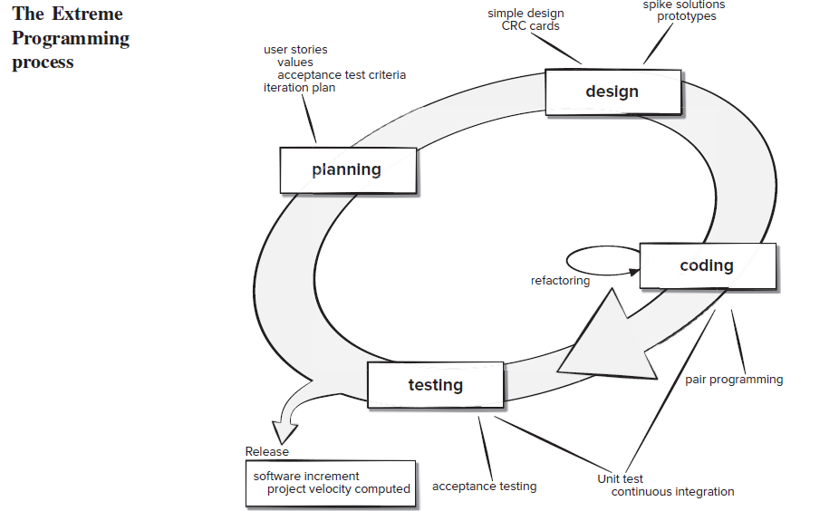
The XP Framework
Extreme Programming encompasses a set of rules and practices that occur within the context of four framework activities: planning, design, coding, and testing.

Slide 17
Kanban
The Kanban method is a lean methodology that describes methods for improving any process or workflow.
Kanban is focused on change management and service delivery.
Change management defines the process through which a requested change is integrated into a software-based system.
Service delivery is encouraged by focusing on understanding customer needs and expectations.
The team members manage the work and are given the freedom to organize themselves to complete it.
Policies evolve as needed to improve outcomes.

Slide 18
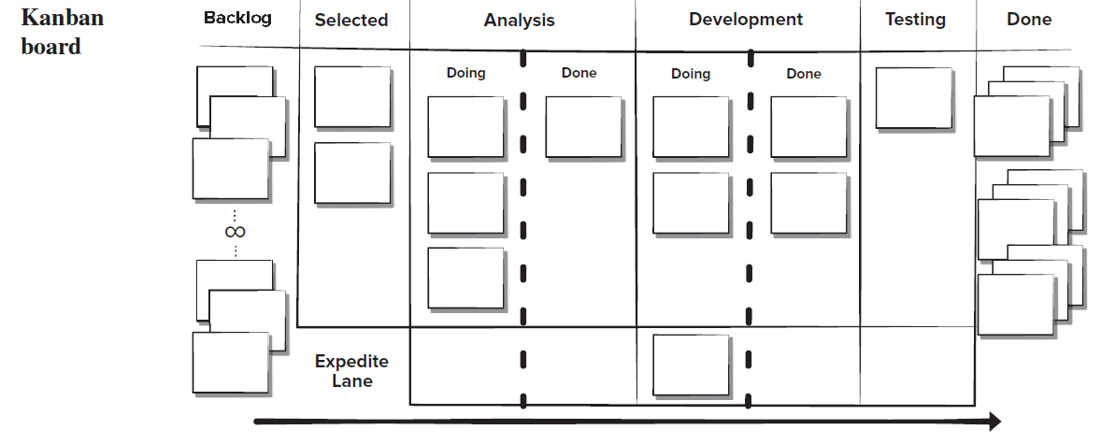
The Kanban board is organized into columns representing the development stage for each element of software functionality. The cards on the board might contain single user stories or recently discovered defects on sticky notes and the team would advance them from “to do,” to “doing,” and “done” as the project progresses.

Slide 19
Kanban
Limiting the amount of work in progress (WIP) at any given time. Developers are encouraged to complete their current task before starting another.
Managing workflow to reduce waste by understanding the current value flow, analyzing places where it is stalled, defining changes, and then implementing the changes.
Making process policies explicit
Focusing on continuous improvement by creating feedback loops
Make process changes collaboratively and involve all team members

Slide 20
DevOps
DevOps was created by Patrick DeBois to combine Development and Operations.
DevOps attempts to apply agile and lean development principles across the entire software supply chain. Figure 3.5 presents an overview of the DevOps workflow.
The DevOps approach involves several stages that loop continuously until the desired product exists:
Continuous development. Software deliverables are broken down and developed in multiple sprints with the increments delivered to the quality assurance members of the development team for testing
Continuous testing. Automated testing tools15 are used to help team members test multiple code increments at the same time to ensure they are free of defects prior to integration.

Slide 21
DevOps
Continuous integration. The code pieces with new functionality are added to the existing code and to the run-time environment and then checked to ensure there are no errors after deployment.
Continuous deployment. At this stage the integrated code is deployed (installed) to the production environment, which might include multiple sites globally that need to be prepared to receive the new functionality.
Continuous monitoring. Operations staff who are members of the development team help to improve software quality by monitoring its performance in the production environment and proactively looking for possible problems before users find them.
DevOps can provide faster deployment time to production platforms

Slide 22
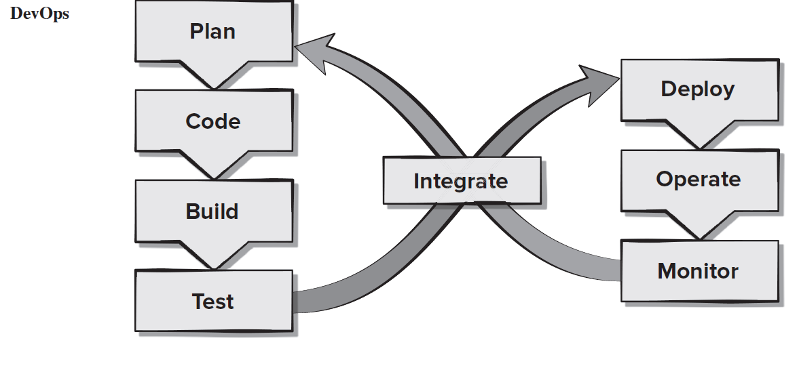

Slide 23
Software Requirement Engineering
Dr. Adeel Ansari

Slide 24
Software Requirements
A complete description of what the software system will do without describing how it will do it is represented by the software requirements
Software requirements are complete specification of the desired external behavior of the software system to be built

Slide 25
Sources of Requirements
Stakeholders
People affected in some way by the system
Documents
Existing system
Domain/business area
Stakeholders describe requirements at different levels of detail
“What versus How”
“One person’s floor is another person’s ceiling”

Slide 26
Examples of Requirements
The system shall allow users to search for an item by title, author, or by International Standard Book Number
The system’s user interface shall be implemented using a web browser
The system shall interface with the central computer to send daily sales and inventory data from every retail store
The system shall maintain records of all payments made to employees on accounts of salaries, bonuses, travel/daily allowances, medical allowances, etc.

Slide 27
Kinds of Software Requirements
Functional requirements
Non-functional requirements
Domain requirements
Inverse requirements
Design and implementation constraints

Slide 28
Functional Requirements
Statements describing what the system does
Functionality of the system
Statements of services the system should provide
Reaction to particular inputs
Behavior in particular situations
Abnormal behavior is also documented as functional requirements in the form of exception handling
Sequencing and parallelism are also captured by functional requirements

Slide 29
Non-Functional Requirements
Most non-functional requirements relate to the system as a whole. They include constraints on timing, performance, reliability, security, maintainability, accuracy, the development process, standards, etc.
Failure to meet a non-functional system requirement may make the whole system unusable
Non-Functional
requirements
Product
requirements
Organizational
requirements
External
requirements

Slide 30
Examples
For example, if an aircraft system does not meet reliability requirements, it will not be certified as ‘safe’
If a real-time control system fails to meet its performance requirements, the control functions will not operate correctly

Slide 31
Product
requirements
Usability
requirements
Efficiency
requirements
Reliability
requirements
Portability
requirements
Performance
requirements
Space
requirements

Slide 32
Organizational Requirements
Organizational
requirements
Standards
requirements
Implementation
requirements
Delivery
requirements

Slide 33
External
requirements
Interoperability
requirements
Ethical
requirements
Legislative
requirements
Privacy
requirements
Safety
requirements
Non-functional requirements should be written in a quantitative manner as much as possible, which is not always easy for customers
For some goals, there are no quantitative measures, e.g., maintainability

Slide 34
Chances of conflicts within non-functional requirements are fairly high, because information is coming from different stakeholders. For example, different stakeholders can give different response times or failure tolerance levels, etc.
Some negotiations must be done among different stakeholders, to achieve an agreement in these situations

Slide 35
Metrics for NFRs - 1
Property | Measure
Speed | Processed transactions/second Response time Screen refresh time
Requirements related to “Speed” can use different measures to quantify the goal

Slide 36
Metrics for NFRs - 2
Property | Measure
Size | K bytes Number of function points
Requirements related to “Size” can use different measures to quantify the goal

Slide 37
Metrics for NFRs - 3
Property | Measure
Ease of use | Training time Number of help frames
Requirements related to “Ease of use” can use different measures to quantify the goal

Slide 38
Metrics for NFRs - 4
Property | Measure
Reliability | Mean time to failure Probability of unavailability Rate of failure occurrence Availability
Requirements related to “Reliability” can use different measures to quantify the goal

Slide 39
Metrics for NFRs - 5
Property | Measure
Robustness | Time to restart after failure Percentage of events causing failure Probability of data corruption on failure
Requirements related to “Robustness” can use different measures to quantify the goal

Slide 40
Metrics for NFRs - 6
Property | Measure
Portability | Percentage of target-dependent statements Number of target systems
Requirements related to “Portability” can use different measures to quantify the goal

Slide 41
Domain Requirements
Requirements that come from the application domain and reflect fundamental characteristics of that application domain
These can be both the functional or non-functional requirements
Domain requirements can impose strict constraints on solutions. This is particularly true for scientific and engineering domains
Domain-specific terminology can also cause confusion

Slide 42
Inverse Requirements
They explain what the system shall not do.
Example:
The system shall not use red color in the user interface, whenever it is asking for inputs from the end-user

Slide 43
Requirements Problems

Slide 44
Requirements Problems - 1
The requirements don’t reflect the real needs of the customer for the system
Requirements are inconsistent and/or incomplete
It is expensive to make changes to requirements after they have been agreed upon

Slide 45
Requirements Problems - 2
There are misunderstandings between customers, those developing the system requirements, and software engineers developing or maintaining the system

Slide 46
Problems with Natural Languages - 1
Requirement specification in natural language pose some problems which include
Lack of clarity
Requirements confusion
Requirements amalgamation

Slide 47
Problems with Natural Languages - 2
Natural language understanding relies on the specification readers and writers using the same words for same concept
A natural language requirements specification is over-flexible.
“You can say the same thing in completely different ways”

Slide 48
Problems with Natural Languages - 3
It is not possible to modularize natural language requirements. It may be difficult to find all related requirements
To discover the impact of a change, every requirement have to be examined

Slide 49
Impact of Wrong Requirements
When requirements are wrong, systems are late, unreliable and don’t meet customers needs
This results in enormous loss of time, revenue, market share, and trust of customers

Slide 50
Coarse-grain Activity Model of the Requirements Engineering Process
Requirements
Elicitation
Requirements
Analysis and
Negotiation
Requirements
Specification
Requirements
Validation
User Needs,
Domain Information,
Existing System
Information, Regulations,
Standards, Etc.
Agreed
Requirements
Requirements
Document

